Slide 1
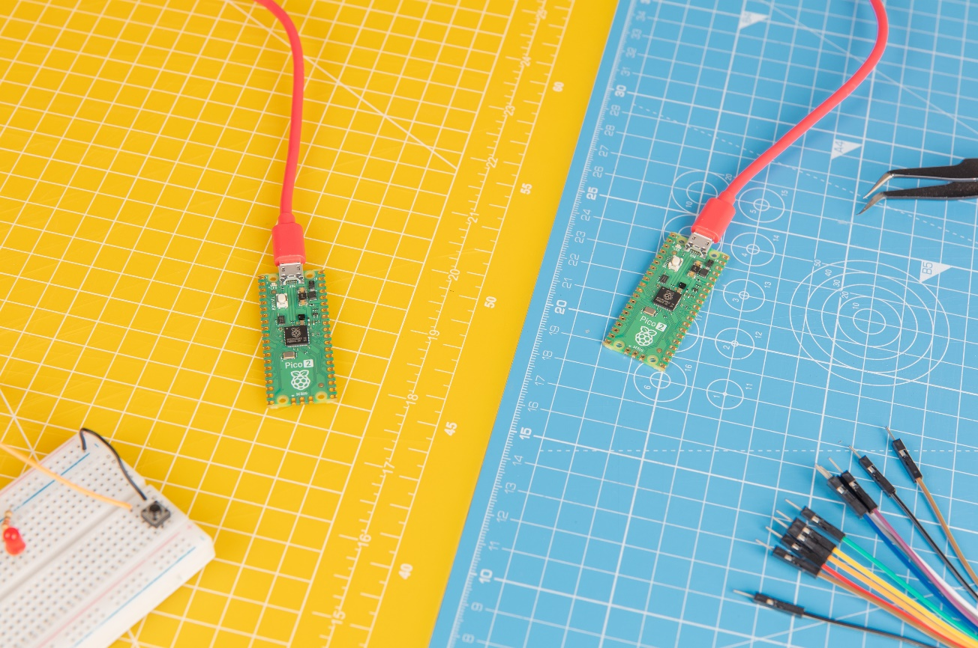

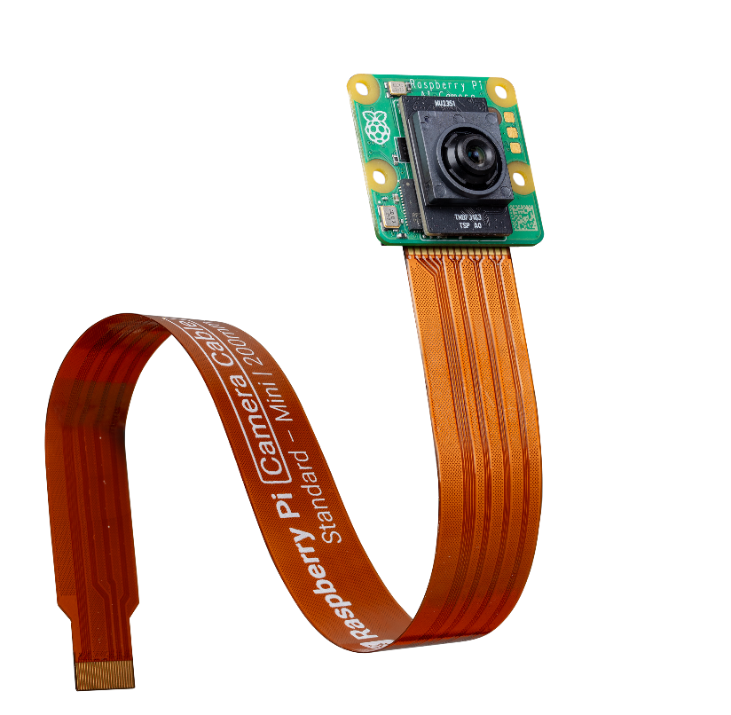
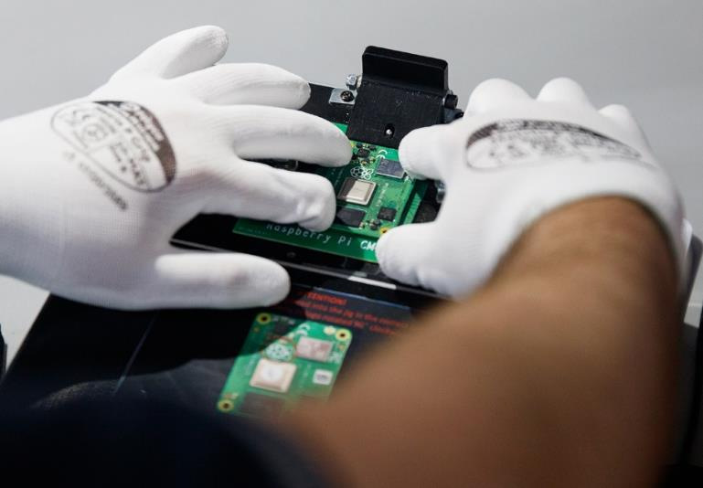
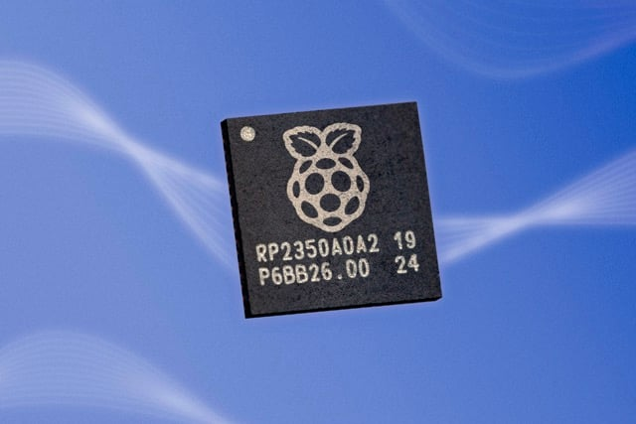

Computing for everybody
December 2024

Slide 2

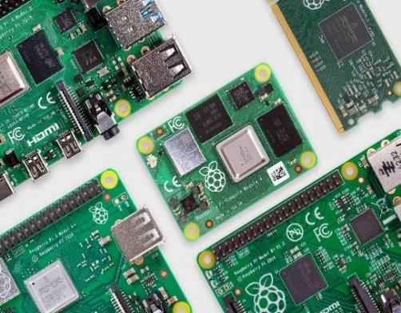

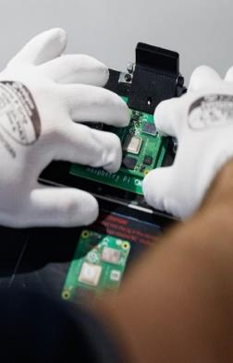





Raspberry Pi at a glance
Our mission: To put high-performance, low-cost, general-purpose computing platforms in the hands of enthusiasts and engineers all over the world
Headquartered in Cambridge UK
Founded 2012, with strong links to Cambridge University and the local engineering community
Lifetime sales of >60 million units
Seven generations of Raspberry Pi Single Board Computers (SBCs) and Compute Modules
Addressing a large and growing market
~$21bn combined market for industrial, embedded, enthusiast, and educational computing
Global sales reach via hybrid channel model
Available via a global network of Approved Resellers and licensees
Supportive strategic shareholder base
Strategic investments underpin partners’ continued commitment to Raspberry Pi
Strong ESG credentials
Leading the world in low-power computing with the smallest resource footprint, funding the Foundation’s mission
Scaled and profitable provider of computing platforms (FY23)
Measurable impact
$266M
Revenue
$66M
Gross Profit
$43M
Adj. EBITDA⁽⁵⁾
29%
Adj. EBITDA CAGR⁽⁵⁾⁽⁶⁾
7.4M
Units sold⁽⁷⁾
$50M
Distributed to the
Raspberry Pi Foundation
to date

Slide 3


H1 2024 Operational Highlights
Successful IPO, strong uptake of Raspberry Pi 5, and launch of new AI product
IPO
Market
Innovation
Commercial progress
Successful IPO raising £178.9m (c. $225m) in total including £31.4m ($40m) for the Company
Returning pre-IPO investors include Arm and Lansdowne
Delivered a strong platform to invest in our technology roadmap and supply chain resilience, and to retain and attract top talent
Completed recovery from pandemic-related supply chain shortages, with almost all SBC and Compute Module products freely available in channel
H1 saw higher than usual customer and channel inventory levels, however we are seeing signs that this should normalise towards the end of the year
Debut first-party AI/ML hardware product (Raspberry Pi AI Kit), in collaboration with Hailo
Debut cloud connectivity product (Raspberry Pi Connect)
Production ramp of RP2350 microcontroller, supporting introduction of Raspberry Pi Pico 2, and partner hardware products, in August
Successful major product transition with Raspberry Pi 5 achieving 1.1m units in H1 2024
Increase in ASPs and Gross Profit per unit across SBCs and Compute Modules
Increase in Gross Profit on Accessories
Growth in Approved Reseller base from 100 to 112
Initiatives to accelerate direct OEM engagement
Raspberry Pi Holdings plc
September 2024

Slide 4





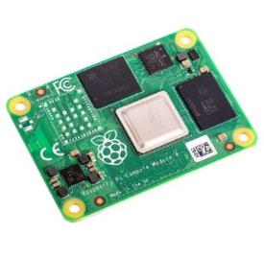
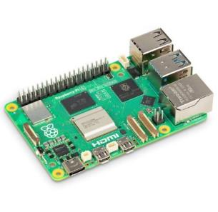



Raspberry Pi products address large, fast-growing markets for computing platforms
Raspberry Pi standard products
Customer archetypes
Market segments
System-on-Modules
Ready-built subsystem that incorporates processor, storage and (optional) networking
SBC
Standalone embedded computers with standards-based external interfaces
Enthusiasts, Makers, Hobbyists
Enthusiast and Education
$4.9B
TAM
Use Raspberry Pi’s SBCs to add intelligence to their personal passion projects
Educators and Students
Educators use Raspberry Pi to teach students, and help them realise their projects
Compute Module
Industrial End-Users
Industrial and Embedded
$16.3B
TAM
Use Raspberry Pi SBCs themselves to add intelligence to industrial processes
OEMs
Integrate Raspberry Pi’s SBCs, compute modules
and custom products at scale, with or without Design Partner assistance
Raspberry Pi Holdings plc
September 2024

Slide 5
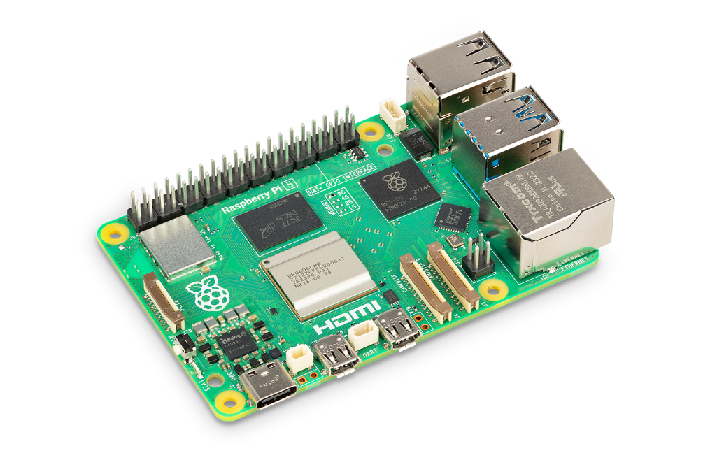
Single board computers address both enthusiast and education, and industrial and embedded markets
Overview
The original Raspberry Pi form factor Nominally designed for enthusiasts and education, but ideally suited to industrial and embedded use Priced from $4-$80
Technical functionality
Provides power management, processing, memory, network connectivity and I/O on a single board Integration via wiring loom or HAT add-on boards
Future development
New Raspberry Pi platforms debut as an SBC Address customer requirements Industrial temperature On-board non-volatile storage Classic product life extension
Prototyping platform leading
to early volumes
Raspberry Pi 5 launch
1.1m units sold in H1 2024 (1.4m units since launch) Reached 1m units in under 6 months, comparable to previous releases 12k units/day peak production capacity at Sony UK Technology Centre
Testimonials
“Proven track record of quality designs and reliable assembly”⁽¹⁾
“The Raspberry Pi 5 is a huge step forward for the tiny, low-cost computing platform”⁽²⁾
Embedded compute for low-to-medium-volume, form-factor-insensitive OEMs
Raspberry Pi Holdings plc
September 2024
Customer testimonials given to Raspberry Pi 2023 https://docs.google.com/spreadsheets/d/1vos2j0ds7sTIqw6CDcN63-cDVyoBvzVathHlIF4bZbA/edit.
https://www.expertreviews.co.uk/raspberry-pi-foundation/raspberry-pi-5-review.
Notes:
Framing the slide
The Pi is our flagship product, a high-performance single board computer and our original Raspberry Pi form factor
Once designed for enthusiasts and education, our Pis are today widely adopted by industrial and embedded customers as well
Our current generation is Pi 5
Product highlights:
It comes with USB, HDMI, Ethernet, WIFI (name the stuff that laymen will know)
Essentially a full desktop computer for 50 bucks, you can plug in a monitor, keyboard and mouse, boot our Raspberry Pi OS and work, surf the web with Chromium
Our models are priced from $25-$80, depending on generation and specifications, speak to a very wide audience
Commercial relevance:
Speak about use case in Education (as desktop computer, thin client, STEM Kit, etc)
Give examples of embedded/industrial low-to-medium-volume applications for form-factor-insensitive OEMs (not too detail)
We still offer our Pi Generation [X] for continued support of our Industrial Customer base
Another highlight of the Pi 5 is that it’s using our in-house designed silicon, the RP1 I/O chip
Explain why this is commercially relevant (performance?, higher gross profit per board?)
Future developments:
Speak about future development/ie improvement to the product, and that Pi Generation always lead the next update wave on the Raspberry Pi hardware
Growth drivers:
Two big upgrades in the future that will broaden our addressable industrial customer base:
Enhanced industrial temperature tolerance
On-board non-volatile storage
What’s driving long-term demand for Pi? As general-purpose computer greatly benefits from convergence of hardware requirements due to similarities in IoT device applications

Slide 6
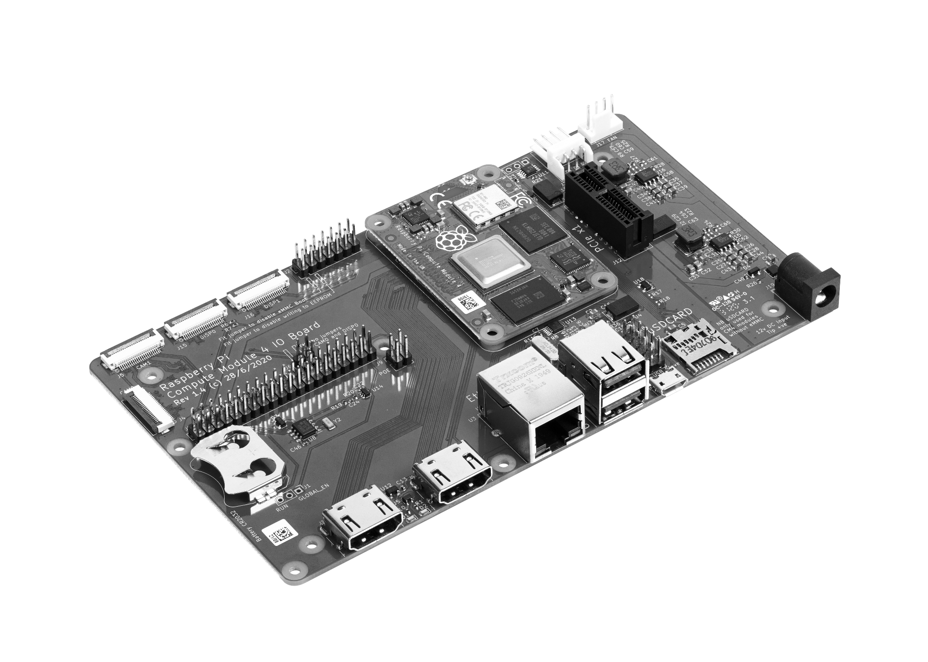
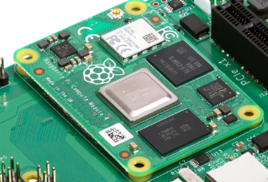
Compute modules allow OEMs to scale with Raspberry Pi
Overview
The core logic and memory of a Raspberry Pi in an alternative, compact form factor for deep-embedded designs Priced from $25-$95
Technical functionality
Eliminates dependency on SBC footprint, connector positioning and onboard peripheral choices All I/O brought out to high-density connectors Trades flexibility for increased integration effort
Future development
Shorten SBC-to-CM delay Retain form-factor compatibility between generations Address customer requirements Industrial temperature Security solutions
Key growth drivers
Drivers broadly similar to those for SBCs Pipeline of SBC customers going to scale Increased complexity of chip-on-board designs influences make-versus-buy dynamics
Testimonials
“Raspberry Pi’s key differentiators include its affordability and strong community support.”⁽¹⁾
“CM4 fits our embedded system needs very well”⁽¹⁾
Embedded compute for medium-to-high-volume, or form-factor-sensitive OEMs
Raspberry Pi Holdings plc
September 2024
Customer testimonials given to Raspberry Pi 2023 https://docs.google.com/spreadsheets/d/1vos2j0ds7sTIqw6CDcN63-cDVyoBvzVathHlIF4bZbA/edit.

Slide 7
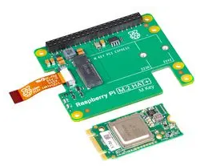


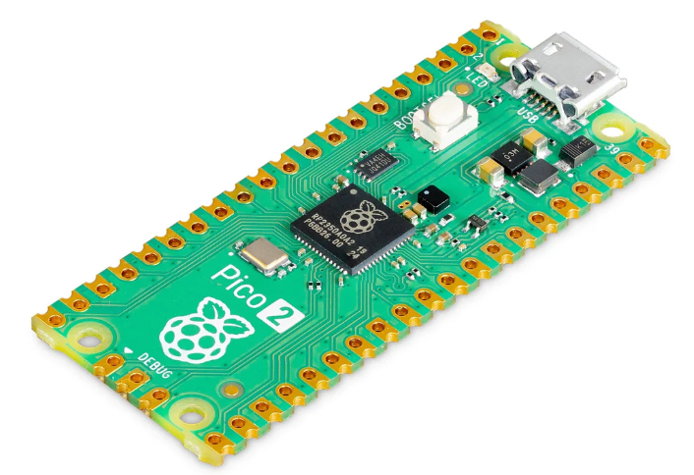
Innovation this year
AI/ML hardware
Raspberry Pi Connect
Raspberry Pi Pico 2
Supports developers in experimenting with neural networks, artificial intelligence and machine learning on a Raspberry Pi 5
Collaboration with Hailo and powered by their H8L acceleration module, capable of 13 trillion operations per second (TOPS)
Priced at just $70, strong demand
Software service providing secure easy-to-use remote access to Raspberry Pi products for industrial and embedded customers
Instance of Raspberry Pi “it just works” mindset
50k users since launch in May 2024
Raspberry Pi Pico products have shipped over 3.5 million units since launch in January 2021
Raspberry Pi Pico 2 offers enhanced performance with faster processors and more memory
Improved interfacing and new security features for professional use
Full compatibility with existing Raspberry Pi Pico hardware and software ecosystem
Designing high-performance, cost-effective computing platforms for Enthusiast, Education and Industrial and Embedded applications
Raspberry Pi Holdings plc
September 2024

Slide 8
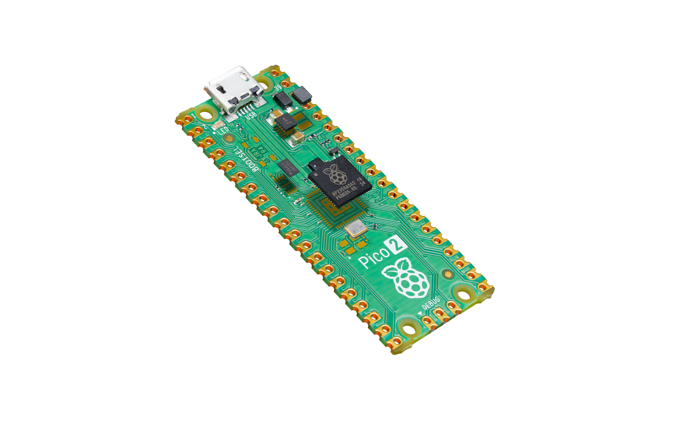
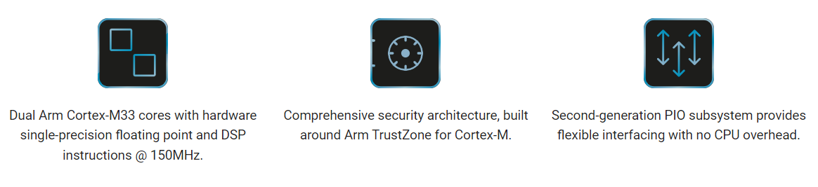
Semiconductors: RP2350 commercial development
Introducing RP235X next generation Microcontrollers
Next generation
microcontroller
Class leading security
key for OEMs
Launch at
DEF CON 2024
2-year development
Higher speed
Lower power consumption
Class leading security
ARM TrustZone for Cortex-M
Protected OTP
Arm or RISC-V security/privilege levels
Released alongside 30+ early adopter developer products
Tested with 3 leading hackers
Launched at DEF CON 2024 to 20,000 attendees with a $20,000 challenge to break it
Raspberry Pi Holdings plc
September 2024

Slide 9









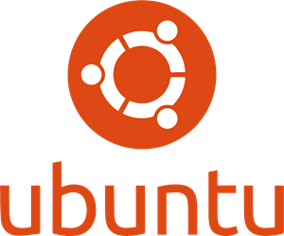





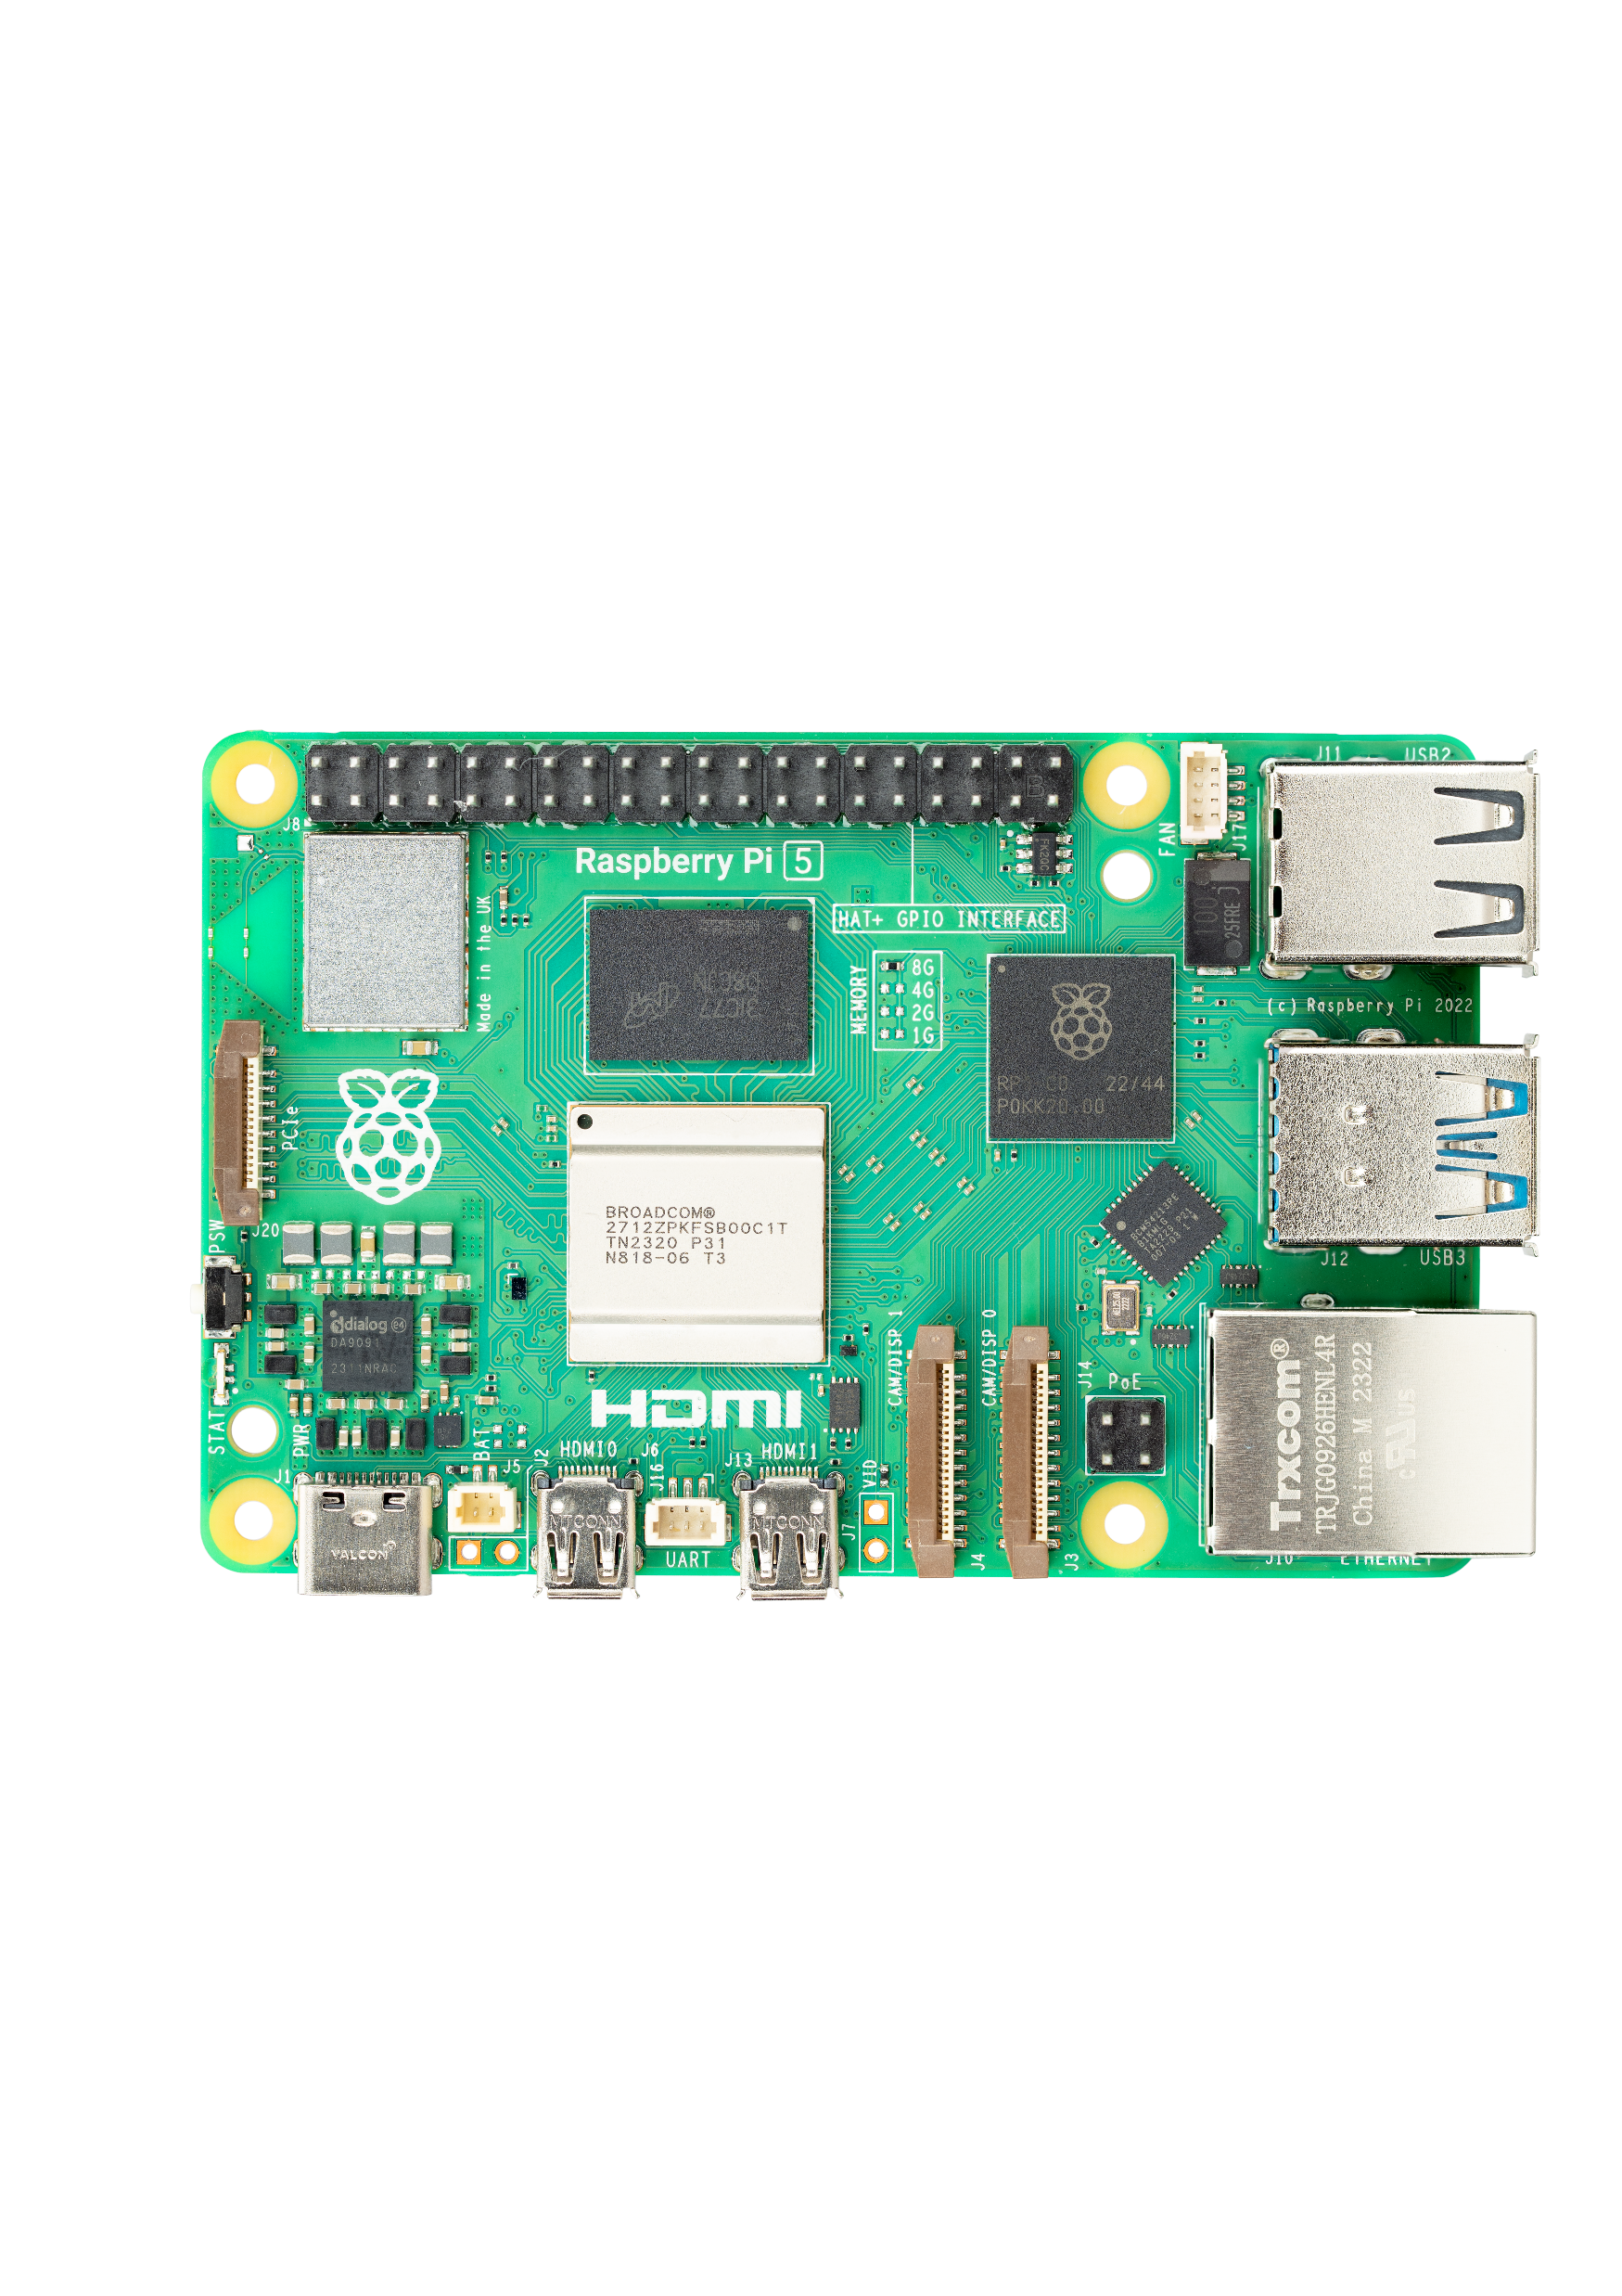
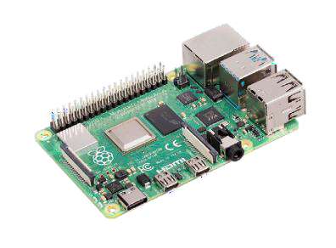
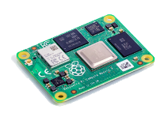
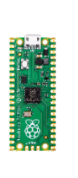


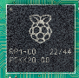

Raspberry Pi’s technology stack starts with the silicon and ends with its Raspberry Pi OS
End-users
Education
Enthusiasts
Industrial and Embedded
Hardware and software must coexist Hardware is useless without software,
and vice versa
3
Operating
System
Raspberry Pi OS
Third-party Operating Systems
Pico-SDK
How does Raspberry Pi make hardware
more useable for customers?
2
Hardware Drivers
Linux Kernel Drivers
Develop and support drivers that talk to and make best use of the hardware
1
Raspberry Pi spans the full technology stack
1
Hardware
Legacy compute
Raspberry Pi 5
Raspberry Pi Pico
Develop and support standard software interfaces and libraries to talk to the drivers
2
Collaborative silicon
Raspberry Pi Silicon
Enables OS developers to support Raspberry Pi products more easily, and simplify the OEM product development process
3
Semiconductor IP
Notes:
At Raspberry Pi we believe that hardware and software must coexist, that’s why we look far beyond the silicon and board an
In fact, our technology stack starts with the silicon and ends with its Raspberry Pi OS, our very own operating system
It’s important to understand that our Integrated Software Platform is a key differentiator vs our competition
Our software is optimized for our hardware and vice versa
Elaborate on the benefits of that: higher performance, lower # malfunctions, higher flexibility, better documentation, larger community
We add software at three key points in our technology stack
Run through from bottom
Develop and support drivers that talk to and make best use of the hardware
support standard software interfaces and libraries to talk to the drivers
Raspberry Pi OS: Enables OS developers to support Raspberry Pi products more easily, and simplify the OEM product development process
We also provide highest flexibility
Customers can use other preferred OS, the use of these will be facilitated through our drivers and libraries
End users will run their applications on top of this
Important to take away: our competition is not providing this level of hardware-software integration
Give some examples

Slide 10
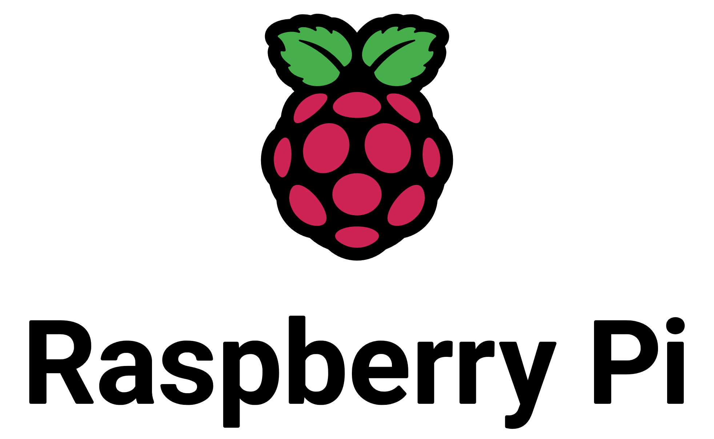
















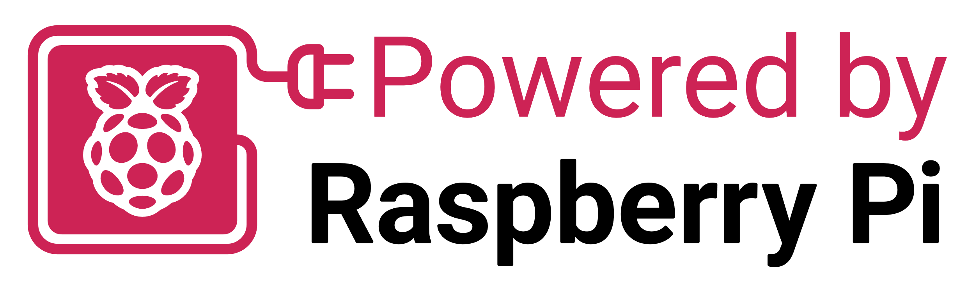



Why Raspberry Pi is different: A true end-to-end engineering organisation
Semiconductor IP Development
Chip design
Chip manufacturing
Board design
Industrial
design
Board manufacturing
Testing and compliance
Software development
Customer
engagement
Capabilities across the value chain create make/buy optionality, and expose opportunities for cost optimization

Slide 11

Peace-of-mind for developers: Raspberry Pi is a highly versatile, supported, and compliant base platform for OEMs
Long-term software support
Raspberry Pi 1 was launched in 2012,
and still supported in the latest Raspberry Pi OS release
Built-in compliance with IoT regulation
Enabling customers to create secure and
compliant IoT solutions based on Raspberry Pi
Software support is frequently cited as a reason why our OEM customers select Raspberry Pi over the competition
Long-term software support, alongside long-term availability of hardware, reduces treadmill costs for OEMs
Security software is a core requirement in hardware selection, particularly as regulatory requirements increase
Raspberry Pi provides security white papers and compliance information
Raspberry Pi supports and develops Raspberry Pi OS to take advantage of security features of the underlying hardware
Illustrative
+
2012
2016
2020
2024
Raspberry Pi 1
Product availability
Product software support availability
The UK Product Security and Telecommunications Infrastructure (Product Security) Regime
Competitor: Product 1
Competitor: Product 2
✔
Long-term platform retention of industrial customers
✔
Preferred choice for young companies seeking a compliant base platform for IoT development
Raspberry Pi’s software support is a key differentiator for OEM customers
Raspberry Pi Ltd
March 2024
Notes:
We strive to make our platform a highly versatile, broadly supported, and compliant base platform for OEMs
Here are two other examples of what our platform offers - this is about peace-of-mind for developers in the I&E space
Run through both examples – compare vs competition

Slide 12





In-house compliance capabilities support OEM customers in bringing their products to the global market
Semiconductor IP Development
Chip design
Chip manufacturing
Board design
Industrial design
Board manufacturing
Testing and compliance
Software development
Customer engagement
Dedicated compliance team and trusted outsourcing partners
Raspberry Pi regulatory compliance activities
Raspberry Pi insources many of its compliance activities, including global market access
Outsourced test providers are used where required by the regulatory regime
Compliance support is made available to OEM customers, either directly from the compliance team, or via the Raspberry Pi Integrator Programme
Customer engagement
Immunity and emissions testing
Regulatory standards in core target markets
The Raspberry Pi Integrator Programme helps embedded customers navigate complicated regulatory compliance issues
Bring OEM products based on Raspberry Pi to market faster, with lower fixed overheads
Access to certificates and conformity documents via Raspberry Pi’s Product Information Portal
Access to the same test engineers who worked on regulatory compliance testing of the base product
✔
✔
✔
Raspberry Pi Ltd
March 2024
Notes:
Compliance is often overlooked, but for us it’s a key in-house capabilities
In our context compliance means … speak about the examples RHS / help navigating complicated regulatory compliance issues
This goes back to our integrated platform approach, which aims at providing complete peace of mind to OEMs and integrators when using our products
We use a mix of in-house resources to own the expertise and augment our capabilities with external providers to be cost-efficient
All efforts are aimed at helping customers bringing their products confidently to market globally
Our dedicated Rpi Integrator Programme is a great example (explain)

Slide 13

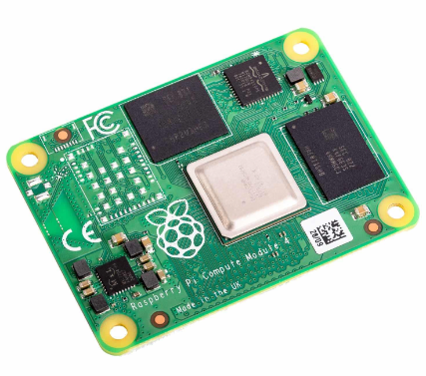
Direct to OEM Case Study: Heathrow
The Challenge Refresh of 3000+ Flight Information Display Systems (FIDS) across Heathrow estate Replacing ten-year-old technology Improve look and performance without increasing cost
Why Raspberry Pi
The Opportunity
Flexible, adaptable and secure
Can be remotely monitored, managed and updated
Low acquisition cost – cost-effective hardware, no license fee for Raspberry Pi OS
Low ongoing cost – reliable, low power consumption
Longevity – available through at least 2034
Hundreds of displays being installed across Terminals 3 and 4
Further roll-out across Terminals 2 and 5
Opportunity to upgrade 300+ Baggage Information Display Systems (BIDS)
Presentations to other airports
Expand the relationship with SHARP/NEC
Partnerships Long-term relationship with SHARP/NEC FIDS team Support by Heathrow Displays Product Owner
Raspberry Pi Holdings plc
September 2024

Slide 14

Raspberry Pi is the leader in versatile computing
 | Award-winning designer of general-purpose computing platforms addressing a $21bn market
 | High-performance, low-cost products provide superior functionality for a diverse range of applications
 | Exceptional brand awareness, loyal community and strong OEM customer base. Trusted by millions of individual users and thousands of enterprises
 | Decade-long track record of revenue growth, profitability and cash generation at scale
 | Seasoned, founder-led team with deep industry expertise
 | Raspberry Pi’s commercial success is complemented by strong ESG credentials
Raspberry Pi Holdings plc
September 2024

Slide 15
Appendix

Slide 16

Raspberry Pi's ESG pillars
Leading the world in low-power computing and democratising technology
The smallest
resource footprint
Funding computer science education
Powering start-ups
and scale-ups
Enabling the developing world
Our computers are more efficient to manufacture, and consume less energy, than legacy desktop and embedded PCs
Compared to a traditional desktop PC:
>90% less wastewater
on PCB manufacture
>85% less electrical power during normal operation
98% less shipping volume
The Foundation focuses on:
Engaging millions of young people in learning computing
Enabling every school to offer students opportunity to study computing
Understanding how young people learn about computing and use that knowledge to increase online learning
Code Club and CoderDojo
The European Astro Pi Challenge and the Raspberry Pi Computing Education Research Centre
Committed to helping businesses bring Raspberry Pi- powered products to market
Raspberry Pi integrator programme helps navigate compliance issues and makes it easier for companies to bring new, exciting products to consumers, in less time and with lower overhead costs
Raspberry Pi Approved Design Partners support integration of Raspberry Pi products on a consultancy basis
We review and approve each ADP to ensure that each has the necessary technical and commercial capabilities
We seek to ensure people anywhere in the world can have access to a Raspberry Pi by:
Supporting resellers in developing nations with 10 resellers in Central and South America, 17 in developing countries in Asia
Seeking resellers in African nations and working to support their activities in low and middle-income countries, supported by The Foundation
Awarded Green Economy Mark by London Stock Exchange
✔
Raspberry Pi Holdings plc
September 2024

Slide 17

Raspberry Pi’s technology leadership, exclusive IP and integrated software platform drive significant competitive moats
Twelve years of building the Raspberry Pi value proposition across hardware, software and the community
✔
✔
✔
✔
✔
Unique DNA
Cultivating the best engineering talent
Entrepreneurial mindset
Placing engineers at the
forefront of innovation
Fabless chip designer
Able to create and develop its own silicon ecosystem
Collaborative silicon
with exclusive supply arrangements
First-party IP
offers independence and a fast time to market
✔
✔
✔
✔
✔
Truly end-to-end
engineering organization covering the value chain
Raspberry Pi OS
Software complements hardware offering
Integrated design ethos
brings high alignment and efficiency
Strong community
with exceptional brand awareness and unique network effects
Fully compliant
with clear documentation and long-term support
Strong Product
Performance
Broad Range
of Revenue Sources
Strong Innovation Capabilities
High Barriers to Entry
De-risking of
Long-term Growth
✔
✔
✔
✔
✔
Raspberry Pi Ltd
September 2024

Slide 18

Software is a cornerstone of Raspberry Pi’s community and generates strong network effects
1
2
…Driving customers towards our integrated software offering…
…Building a stronger community, and generating more third-party collateral…
Developer concerns
Raspberry Pi’s integrated software platform
Strong network effects
Software is critical when developing an
embedded application
Raspberry Pi is a "Yes" to all of these questions
Community engagement builds
a richer ecosystem
Does it work?
Is it easy to use?
Ease of use: Robust driver support for platform hardware, showcased in Raspberry Pi OS
Third-party OS support: Raspberry Pi hardware platforms are supported by many other operating systems
Strong community: Twelve years track record of working with the community to support their requirements
Network effects: Community engagement supports a rich ecosystem, and the creation of more third-party software, documentation, and other collateral
Brand equity: This ecosystem builds trust in our platform among enthusiasts, educators, and industrial and embedded customers
Do I trust the supplier?
Is it secure?
Is there support if I have problems?
…Resulting in top-of-mind awareness and brand visibility…
…Improving the value of Raspberry Pi’s integrated platform…
4
3
Twelve years working with the community has created a rich, robust ecosystem around the Raspberry Pi platform
Raspberry Pi Ltd
March 2024
Notes:
Our year-long investments into software are paying off in a wonderful way: we have a vibrant community that generates strong network effects for our ecosystem
Put yourself into a developer’s/OEM’s shoes at the beginning of product development
List the concerns, end with software and how critical it is software today
Naturally, developers will be driven towards our integrated software offering
Our Raspberry Pi Integrated Software Paltform is a "Yes" to all of these questions – list the bullets
With all these developers, educators, enthusiasts using our platform, we have created a massive global community that generates more third-party collateral – list bullets
As a result of higher engagement, our integrated software platform becomes even more richer and valuable
Which enhances the top-of-mind awareness and brand visibility of Raspberry Pi – Raspberry is even more front in center for developers at the beginning of this journey
This is further supported by strong presence in E&E market
Bottom line is that Twelve years working with the community has created a rich, robust ecosystem around the Raspberry Pi platform
Competition doesn’t bring this value-add to the table
Free marketing

Slide 19











 | Enthusiast and Education | Raspberry Pi | Industrial and Embedded
◔ (Low) ◑ (Medium) ● (High)
Price performance ratio | ◕ | ● | ◔
Free software support | ◔ | ● | ◑
Community | ◔ | ● | ◔
Vertically integrated proposition | ◔ | ● | ●
Long-term availability of stock | ◔ | ● | ●
Peripheral and accessories integration | ◑ | ● | ◑
Raspberry Pi Ltd
March 2024
Note: Based on management view.

Slide 20
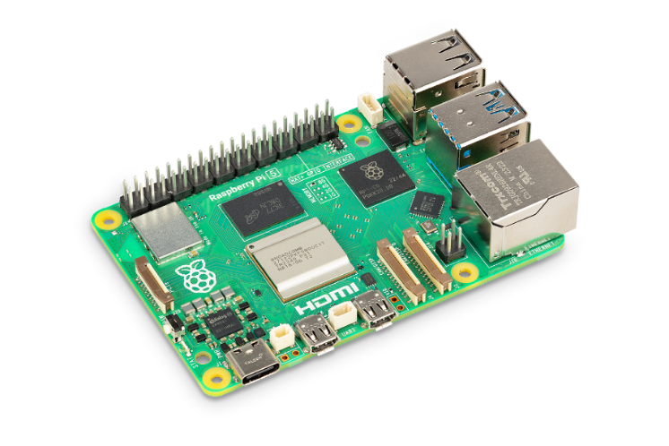
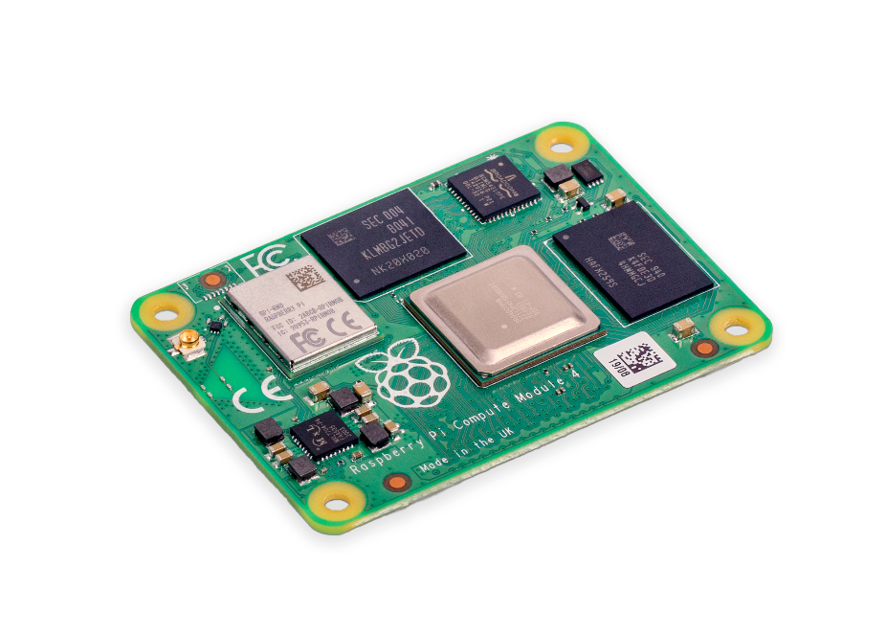
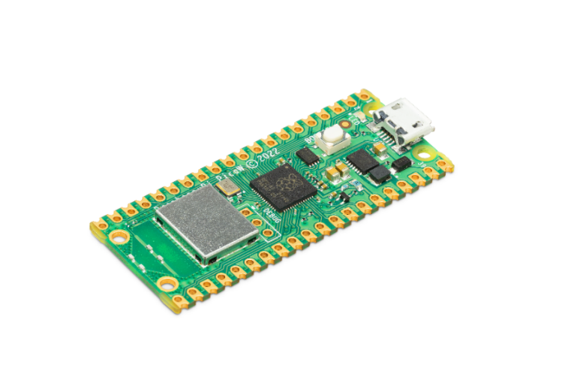
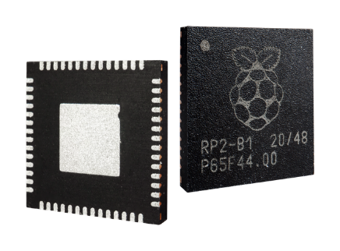







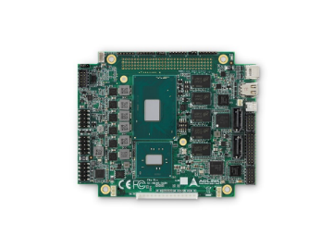
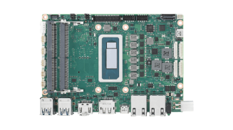
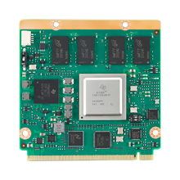
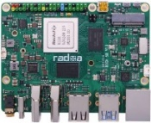
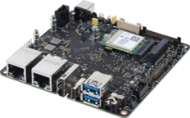
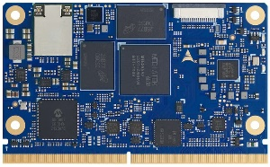
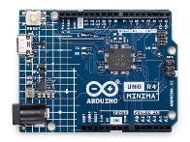

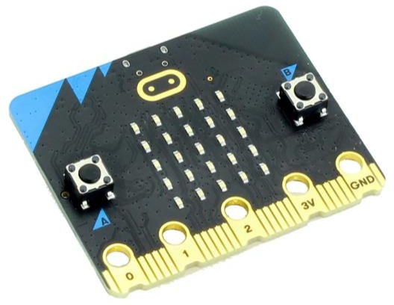

Our products vs alternative offerings
Single Board Computer
Compute Module
Microcontroller
Raspberry Pi Product
Raspberry Pi Pico
Raspberry Pi RP2040
Alternatives
ROCK Pi 5
Model B
Tinkerboard 3N
Arduino Uno
ADLINK LEC-MKT-I1200
ROM-7510
Raspberry Pi Advantage
✔
Software
✔
Community
✔
Cost
Raspberry Pi Ltd
March 2024
Notes:
https://tinker-board.asus.com/series/tinker-board-3N.html
https://www.toradex.com/computer-on-modules/apalis-arm-family/nxp-imx-8
https://www.okdo.com/p/okdo-rock-5-model-b-8gb-single-board-computer-rockchip-rk3588-arm-cortex-a76-cortex-a55/
https://store.arduino.cc/products/uno-r4-minima?_gl=1*1js8v1z*_ga*MTA5NjI0NzEzNy4xNzA3OTE0MTAy*_ga_NEXN8H46L5*MTcwNzkxNDEwMi4xLjEuMTcwNzkxNDExOS4wLjAuMA..*_fplc*MWdHcVdUJTJCNGQ0ZSUyQnpLSnNudnV3NFJqcTFUUzVVRXhyaWdON05CTks2NFhMQmxQdHZtR1ZTSW9icVJQOERsZVdGYXRkUWZtdjlOdHp3N2g2MHJxTTNsYkdNZXFYRGxGNHc5WmlNJTJGaU9DMlZpZXdaWGZQViUyRkhoMzhYSmtQMHclM0QlM0Q.
https://www.variscite.com/product/system-on-module-som/cortex-a53-krait/var-som-mx8m-nano-nxp-i-mx-8m-nano/

